Slide 1




ঋ
lesson 1
Quiz 1
lesson 2
Quiz 2
lesson 3
Quiz 3
lesson 4
Quiz 4
lesson 5
Quiz 5
lesson 6
Quiz 6

Slide 2
রেফ
lesson 7
Quiz 7
lesson 8
Quiz 8
lesson 9
Quiz 9
lesson 10
Quiz 10
lesson 11
Quiz 11
sentence
Megaquiz

Slide 3
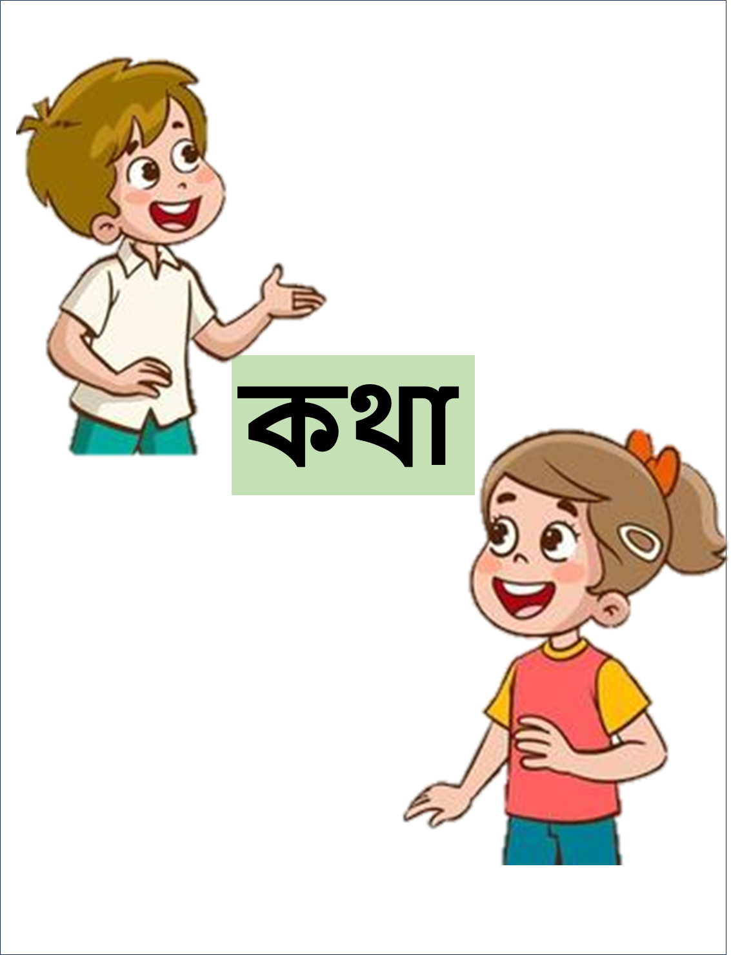


আ-কার

Slide 4
ই-কার
ঐ-কার
lesson 1
Quiz 1
lesson 2
Quiz 2
lesson 3
Quiz 3
lesson 4
Quiz 4
lesson 5
Quiz 5
lesson 6
Quiz 6

Slide 5
ঈ-কার
lesson 7
Quiz 7
lesson 8
Quiz 8
lesson 9
Quiz 9
lesson 10
Quiz 10
lesson 11
Quiz 11
sentence
Megaquiz

Slide 6
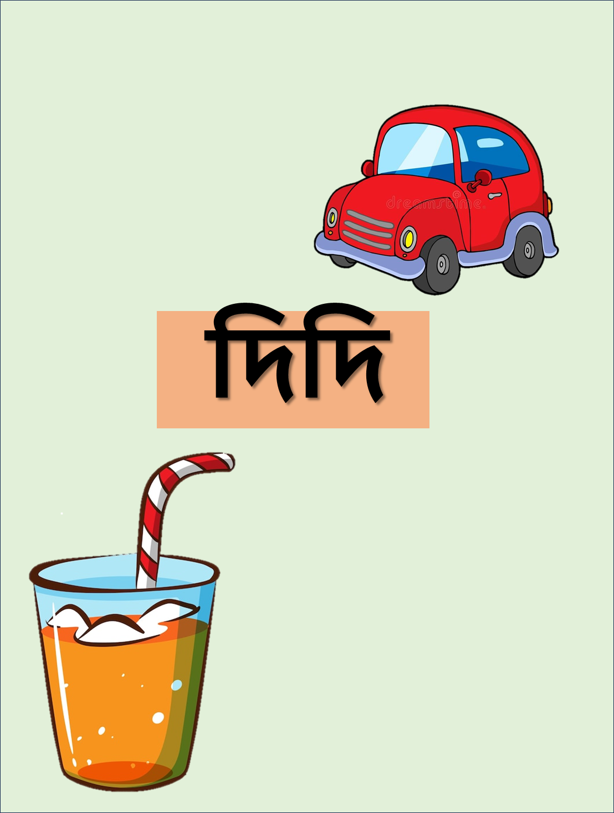


ই-কার/ ঈ-কার

Slide 7
উ-কার
ঊ-কার
lesson 1
Quiz 1
lesson 2
Quiz 2
lesson 3
Quiz 3
lesson 4
Quiz 4
lesson 5
Quiz 5
lesson 6
Quiz 6

Slide 8
ঊ-কার
lesson 7
Quiz 7
lesson 8
Quiz 8
lesson 9
Quiz 9
lesson 10
Quiz 10
lesson 11
Quiz 11
sentence
Megaquiz

Slide 9


উ-কার/ ঊ-কার

Slide 10
এ-কার
ঐ-কার
lesson 1
Quiz 1
lesson 2
Quiz 2
lesson 3
Quiz 3
lesson 4
Quiz 4
lesson 5
Quiz 5
lesson 6
Quiz 6

Slide 11
ঐ-কার
lesson 7
Quiz 7
lesson 8
Quiz 8
lesson 9
Quiz 9
lesson 10
Quiz 10
lesson 11
Quiz 11
sentence
Megaquiz

Slide 12
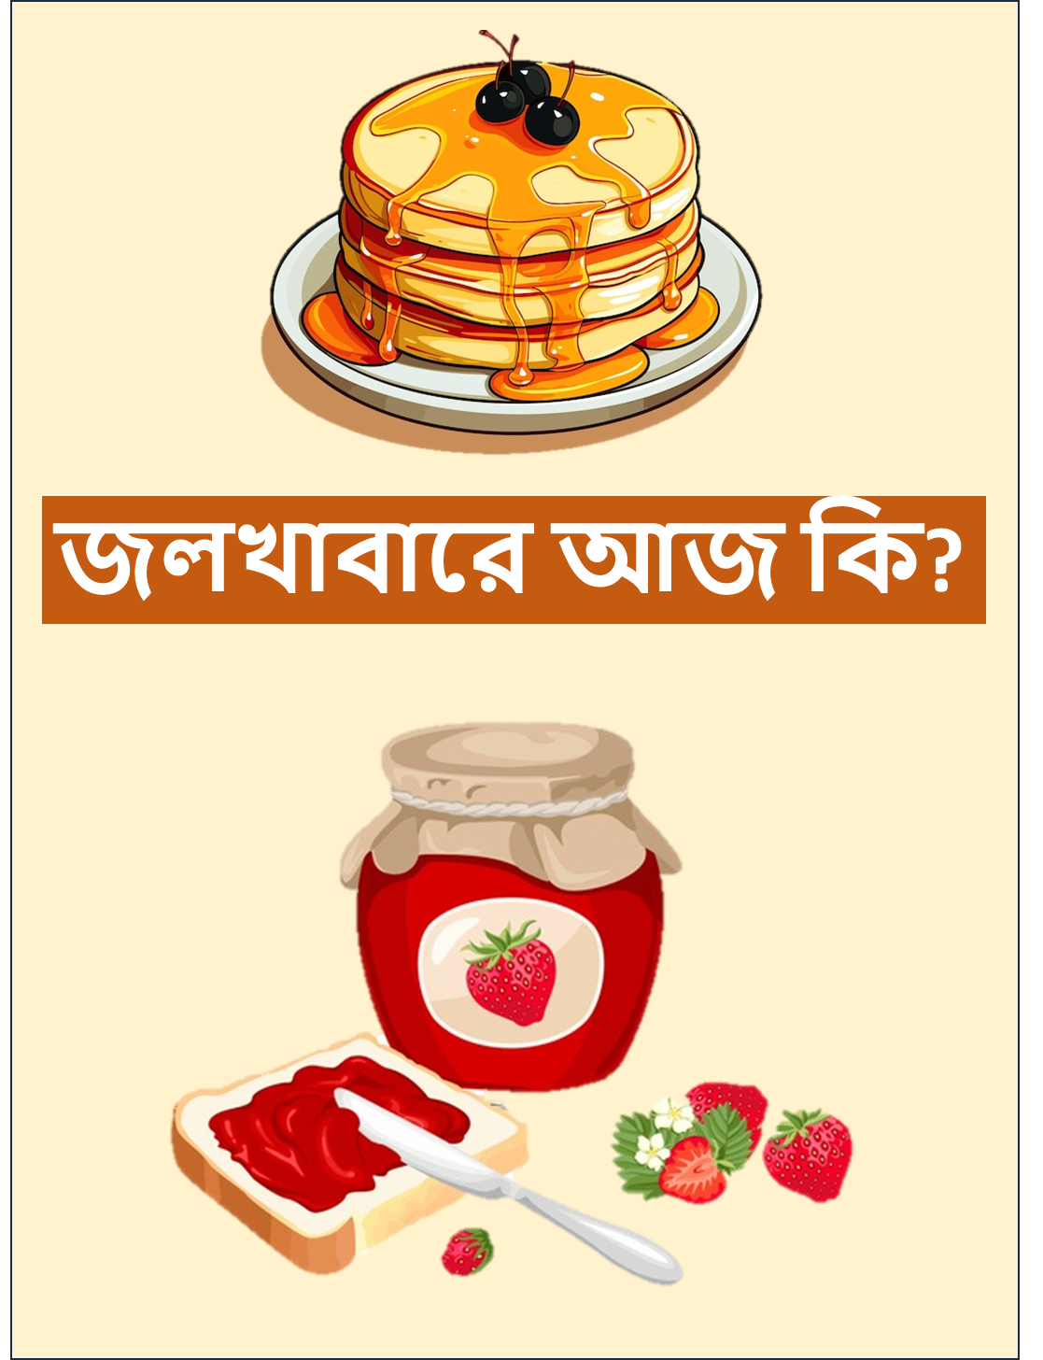

এ-কার/ঐ-কার

Slide 13
ঔ-কার
ঔ-কার
lesson 1
Quiz 1
lesson 2
Quiz 2
lesson 3
Quiz 3
lesson 4
Quiz 4
lesson 5
Quiz 5
lesson 6
Quiz 6

Slide 14
ও-কার
lesson 7
Quiz 7
lesson 8
Quiz 8
lesson 9
Quiz 9
lesson 10
Quiz 10
lesson 12
Quiz 12
sentence
Megaquiz

Slide 15


ও-কার/ঔ-কার

